Slide 1
Concavity and Points of Inflection

Slide 2
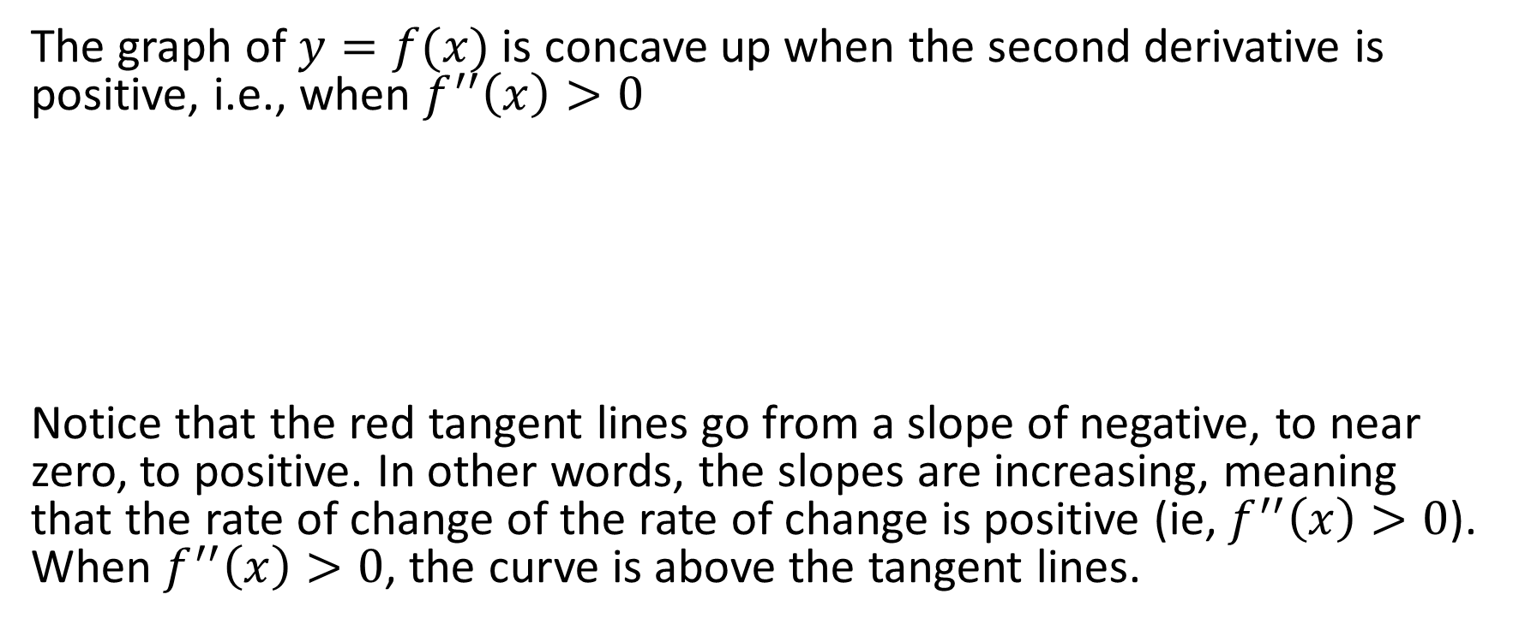


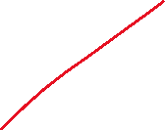
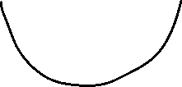
Concave Up; $f^{′′}\left(x\right)>0$
The graph of $y=f(x)$ is concave up when the second derivative is positive, i.e., when $f^{′′}\left(x\right)>0$
Notice that the red tangent lines go from a slope of negative, to near zero, to positive. In other words, the slopes are increasing, meaning that the rate of change of the rate of change is positive (ie, $f^{′′}\left(x\right)>0$). When $f^{′′}\left(x\right)>0$, the curve is above the tangent lines.

Slide 3
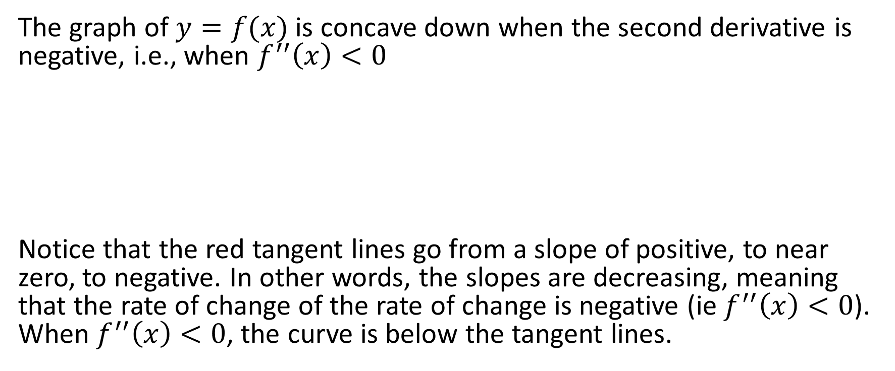
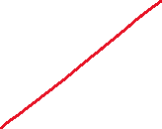

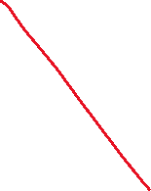
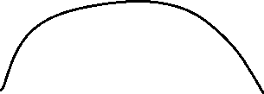

Concave Down; $f^{′′}\left(x\right)<0$
The graph of $y=f(x)$ is concave down when the second derivative is negative, i.e., when $f^{′′}\left(x\right)<0$
Notice that the red tangent lines go from a slope of positive, to near zero, to negative. In other words, the slopes are decreasing, meaning that the rate of change of the rate of change is negative (ie $f^{′′}\left(x\right)<0$). When $f^{′′}\left(x\right)<0$, the curve is below the tangent lines.

Slide 4

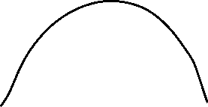

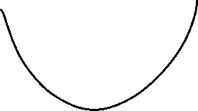
Second Derivative Test
If at a given point, $f^{′}\left(x\right)=0$ and $f^{′′}\left(x\right)>0$, then there is a local minimum.
If at a given point, $f^{′}\left(x\right)=0$ and $f^{′′}\left(x\right)<0$, then there is a local maximum.

Slide 5
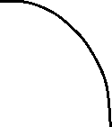

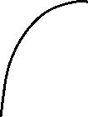


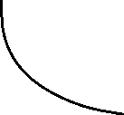


Points of Inflection
Points at which $f^{′′}\left(x\right)=0$ are called points of inflection.
The red points are points of inflection.

Slide 6

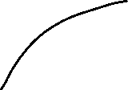

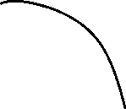
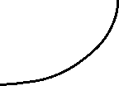

Putting Together $f′(x)$ and $f′′(x)$
$f^{′}\left(x\right)>0$ and $f^{′′}\left(x\right)>0$ $f^{′}\left(x\right)>0$ and $f^{′′}\left(x\right)<0$
$f^{′}\left(x\right)<0$ and $f^{′′}\left(x\right)>0$ $f^{′}\left(x\right)<0$ and $f^{′′}\left(x\right)<0$

Slide 7
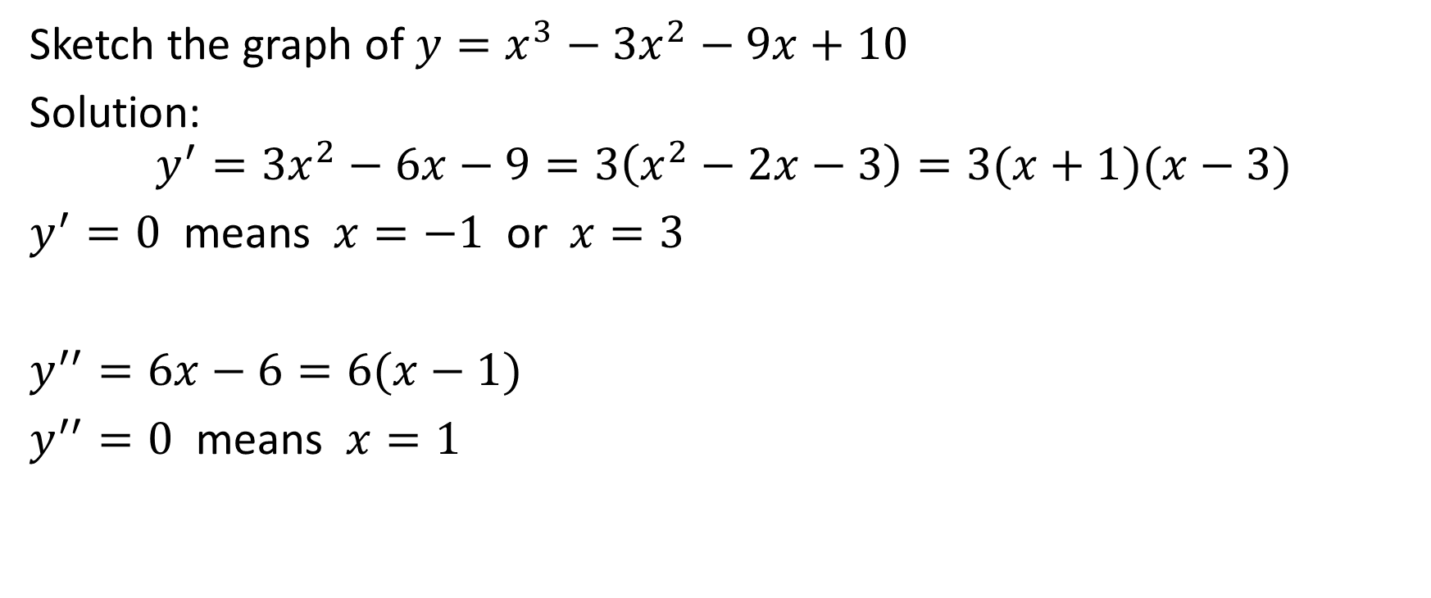
Example
Sketch the graph of $y=x^{3}−3x^{2}−9x+10$
Solution:
$$y^{′}=3x^{2}−6x−9=3\left(x^{2}−2x−3\right)=3(x+1)(x−3)$$
$y^{′}=0$ means $x=−1$ or $x=3$
$y^{′′}=6x−6=6(x−1)$
$y^{′′}=0$ means $x=1$

Slide 8
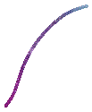



.

Slide 9

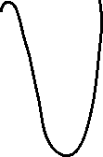



At x = -1, $y={(−1)}^{3}−3{\left(−1\right)}^{2}−9\left(−1\right)+10=15 → (−1,15)$
At x = 1, $y={(1)}^{3}−3{\left(1\right)}^{2}−9\left(1\right)+10= −1 → (1,−1)$
At x = 3, $y={(3)}^{3}−3{\left(3\right)}^{2}−9\left(3\right)+10=−17 → (3,−17)$

Slide 10
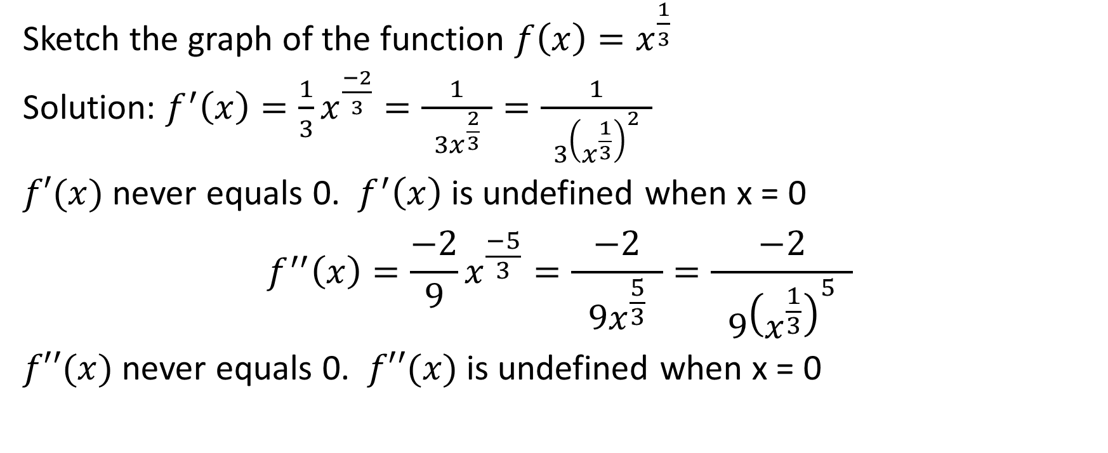
Example
Sketch the graph of the function $f\left(x\right)=x^{\frac{1}{3}}$
Solution: $f^{′}\left(x\right)=\frac{1}{3}x^{\frac{−2}{3}}=\frac{1}{ 3x^{\frac{2}{3}} }=\frac{1}{ 3{\left(x^{\frac{1}{3}}\right)}^{2} }$
$f′(x)$ never equals 0. $f^{′}\left(x\right)$ is undefined when x = 0
$$f^{′′}\left(x\right)=\frac{−2}{9}x^{\frac{−5}{3}}=\frac{−2}{ 9x^{\frac{5}{3}} }=\frac{−2}{ 9{\left(x^{\frac{1}{3}}\right)}^{5} }$$
$f′′(x)$ never equals 0. $f′′(x)$ is undefined when x = 0

Slide 11

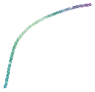



.

Slide 12


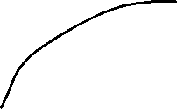

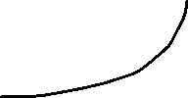
At x = 0, $y={(0)}^{\frac{1}{3}}=0$ Therefore, the point is (0, 0)

Slide 13
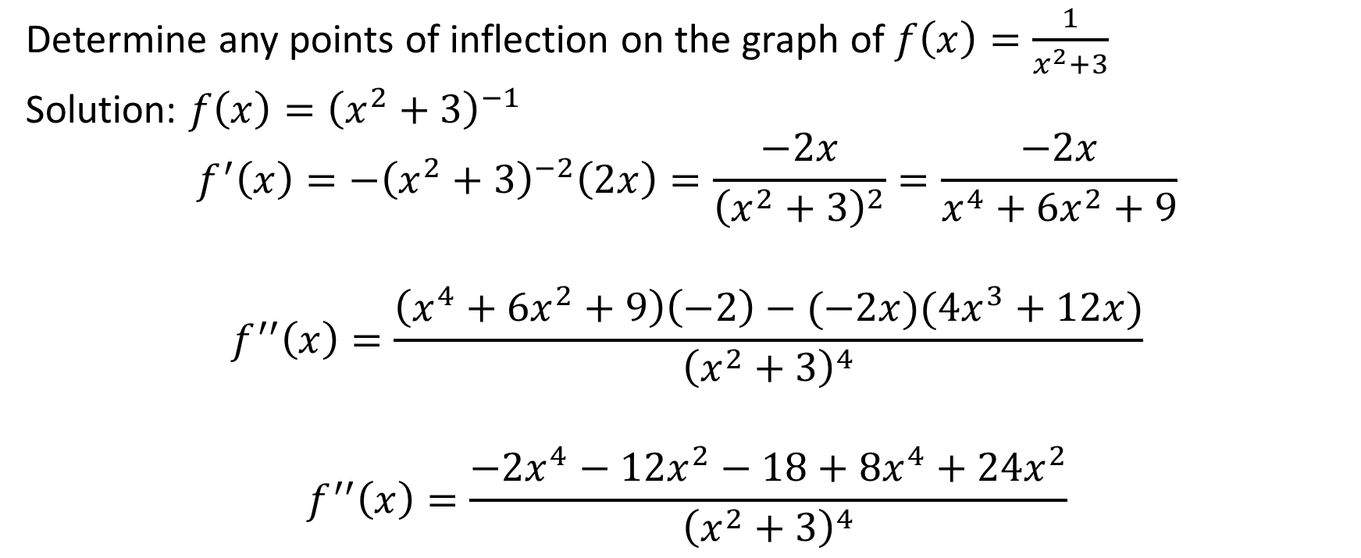
Example
Determine any points of inflection on the graph of $f\left(x\right)=\frac{1}{x^{2}+3}$
Solution: $f\left(x\right)={\left(x^{2}+3\right)}^{−1}$
$$f^{′}\left(x\right)=−{\left(x^{2}+3\right)}^{−2}\left(2x\right)=\frac{−2x}{{\left(x^{2}+3\right)}^{2}}=\frac{−2x}{x^{4}+6x^{2}+9}$$
$$f^{′′}\left(x\right)=\frac{\left(x^{4}+6x^{2}+9\right)\left(−2\right)−(−2x)(4x^{3}+12x)}{{\left(x^{2}+3\right)}^{4}}$$
$$f^{′′}\left(x\right)=\frac{−2x^{4}−12x^{2}−18+8x^{4}+24x^{2}}{{\left(x^{2}+3\right)}^{4}}$$

Slide 14
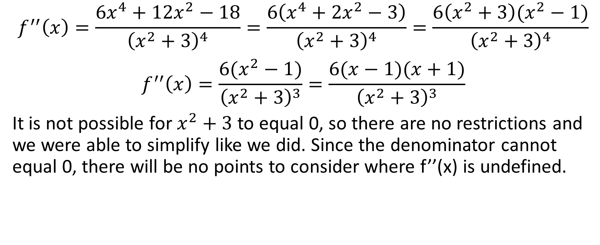
$$f^{′′}\left(x\right)=\frac{6x^{4}+12x^{2}−18}{{\left(x^{2}+3\right)}^{4}}=\frac{6\left(x^{4}+2x^{2}−3\right)}{{\left(x^{2}+3\right)}^{4}}=\frac{6\left(x^{2}+3\right)(x^{2}−1)}{{\left(x^{2}+3\right)}^{4}}$$
$$f^{′′}\left(x\right)=\frac{6(x^{2}−1)}{{\left(x^{2}+3\right)}^{3}}=\frac{6(x−1)(x+1)}{{\left(x^{2}+3\right)}^{3}}$$
It is not possible for $x^{2}+3$ to equal 0, so there are no restrictions and we were able to simplify like we did. Since the denominator cannot equal 0, there will be no points to consider where f’’(x) is undefined.

Slide 15
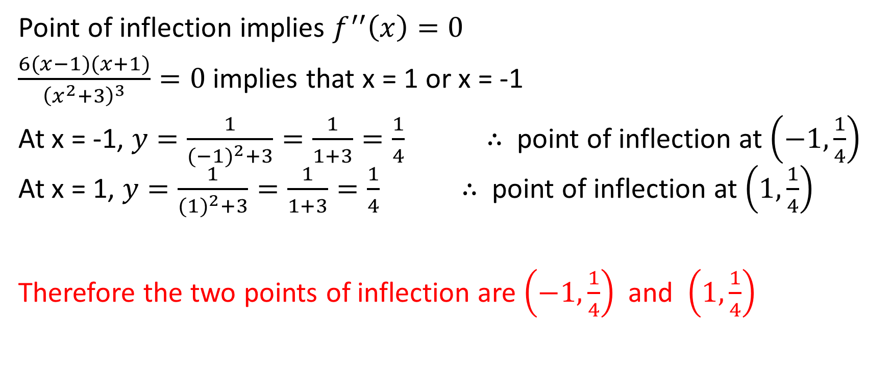
Point of inflection implies $f^{′′}\left(x\right)=0$
$\frac{6(x−1)(x+1)}{{\left(x^{2}+3\right)}^{3}}=0$ implies that x = 1 or x = -1
At x = -1, $y=\frac{1}{{(−1)}^{2}+3}=\frac{1}{1+3}=\frac{1}{4}$ $∴$ point of inflection at $\left(−1,\frac{1}{4}\right)$ At x = 1, $y=\frac{1}{{(1)}^{2}+3}=\frac{1}{1+3}=\frac{1}{4}$ $∴$ point of inflection at $\left(1,\frac{1}{4}\right)$
Therefore the two points of inflection are $\left(−1,\frac{1}{4}\right)$ and $\left(1,\frac{1}{4}\right)$

Slide 16
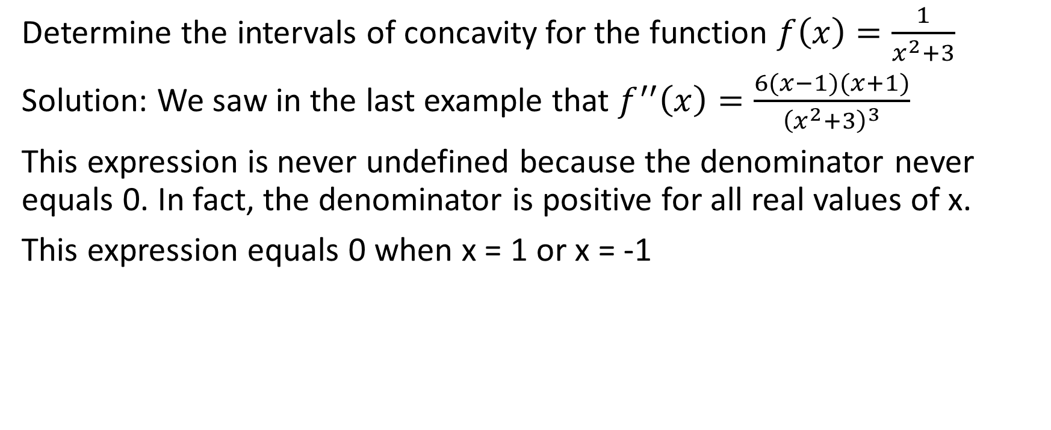

Example
Determine the intervals of concavity for the function $f\left(x\right)=\frac{1}{x^{2}+3}$
Solution: We saw in the last example that $f^{′′}\left(x\right)=\frac{6(x−1)(x+1)}{{\left(x^{2}+3\right)}^{3}}$
This expression is never undefined because the denominator never equals 0. In fact, the denominator is positive for all real values of x.
This expression equals 0 when x = 1 or x = -1

Slide 17
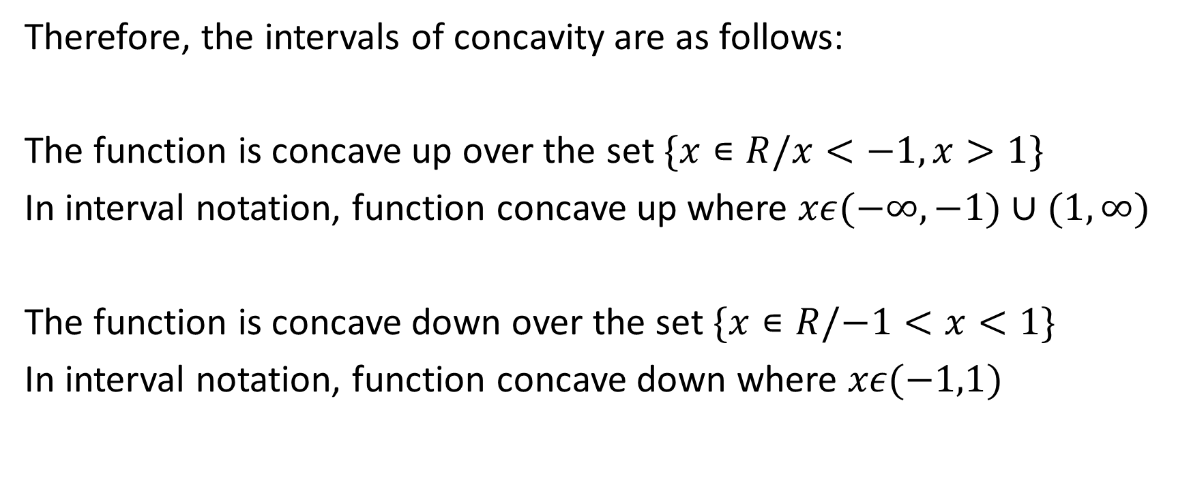
Therefore, the intervals of concavity are as follows:
The function is concave up over the set $\{x∊R/x<−1,x>1\}$
In interval notation, function concave up where $xε(−∞,−1)∪(1,∞)$
The function is concave down over the set $\{x∊R/−1<x<1\}$
In interval notation, function concave down where $xε(−1,1)$

